Slide 1

AuE-8230 Autonomy: Science and Systems
Capstone Project
Group 1: Chinmay Samak, Tanmay Samak
Codebase

Slide 2
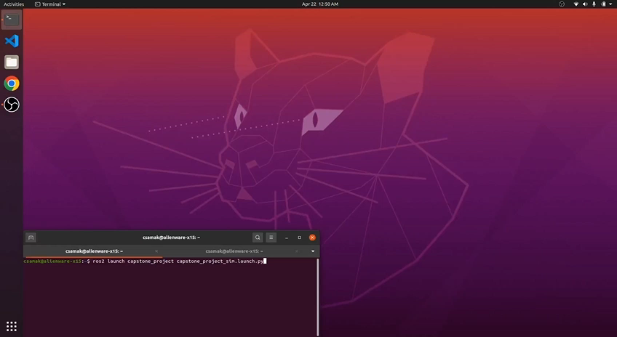
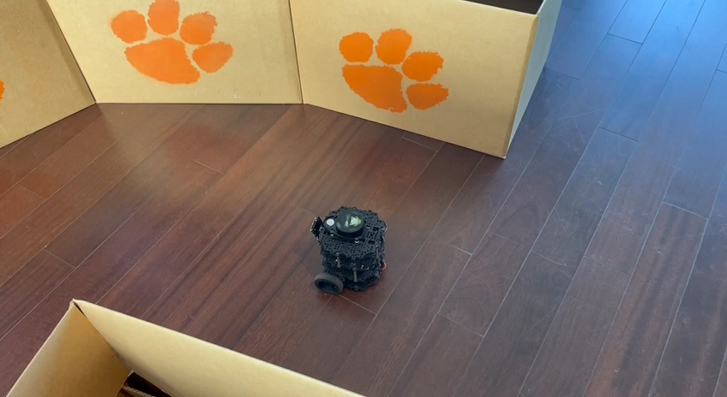
Robustness Testing
Simulation
Forward Direction;
Start with Wall Following
Reality
Day; Forward Direction;
Start at Wall Following

Slide 3
Thank you!
…open to questions and suggestions

